Slide 5
Lesson 1: Estimating Crowds
EQ: How would you use ratios to determine the size if a crowd?
**Standard**

Slide 6
1. Convert to same unit of measure
2. Find Area/Volume
3. Set up ratio
4. Solve
- remember: people are whole numbers

Slide 7
Note: units must be consistent (numerator and denominator)
Conversions: Formulas:
1 inch = 25.4 mm (A)Square = s2
1 foot = 12 inches (A)Rectangle =l*w
1 yard = 3 feet (A)Circle =
1 mile = 5,280 feet
1 mile = 1,760 yards Volume = l*w*h

Slide 8
Let's try:
10 People fit comfortably in a 5 feet by 5 feet area. Use ​this value to estimate the size of a crowd that is 5 feet ​deep and 25 feet long.
1st ex.

Slide 9
Post it ​check
Your turn:
6 People fit comfortably in a 4 feet by 4 feet area. Use this value ​ ​to estimate the size of a crowd that is 16 feet deep and 20 feet ​long.

Slide 10
Example 2 (add prac.):
8 People fit comfortably in a 6 feet by 6 feet area. Use this value ​ ​to estimate the size of a crowd that is 13 feet deep and 25 feet ​long.

Slide 11
Let's try this one......we gotta convert!
6 People fit comfortably in a 3 feet by 3 feet area. Use this ​value to estimate the size of a crowd that is 2 yards deep ​and 18 feet long.

Slide 12
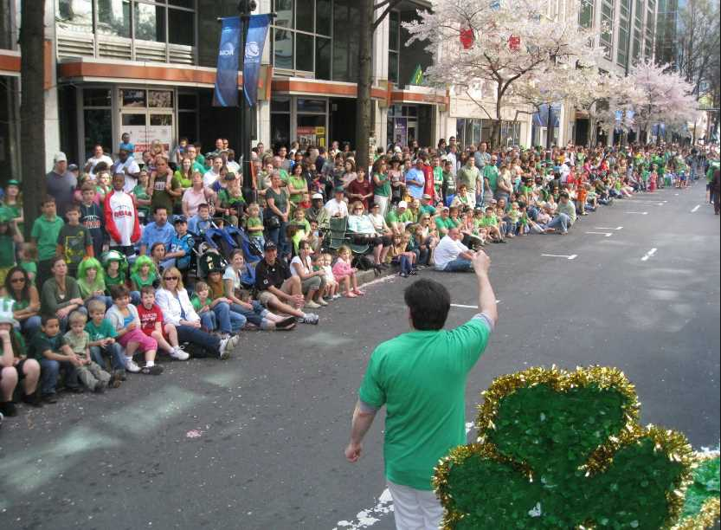
You try this one:
6 People fit comfortably in a 4 feet by 4 feet area. ​Use this value to estimate the size of a crowd that ​is 2 yards deep and 1 mile long.
Post it ​check

Slide 13
How do we solve this?
One person fits comfortably in an area of 3.5 square feet. How many people are in a crowd that spans 4 yards deep and 1 mile long?

Slide 14
One person fits comfortably in an area of 2.75 square feet. A crowd that spans 15 feet deep and 3.25 miles long. How many people are there if the crowd is on both sides of the street?
Post it ​check

Slide 16
Sum it up....
Yesterday's activity included predicting how many people would fit comfortably in a 5 feet by 5 feet square. If we could fit 20 people in that space, answer the following:
A. How many people could we fit in the hallway (1st floor) if it measured 18 feet wide and 57 yards long?
B. How many people would fit if it were the 1st and 2nd floors of this building (given equal measurements)?

Slide 17
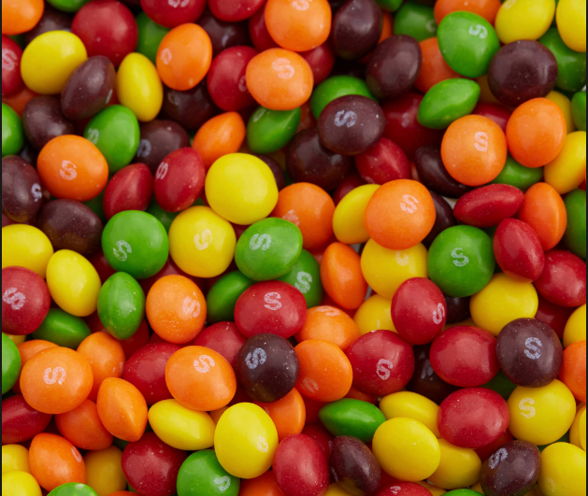
How many are ​there?

Slide 18
EQ: How do I determine how many objects can fill up a space?
Let's talk Volume!
Formulas:
Volume of cube/box = l*w*h
Volume of sphere =

Slide 19
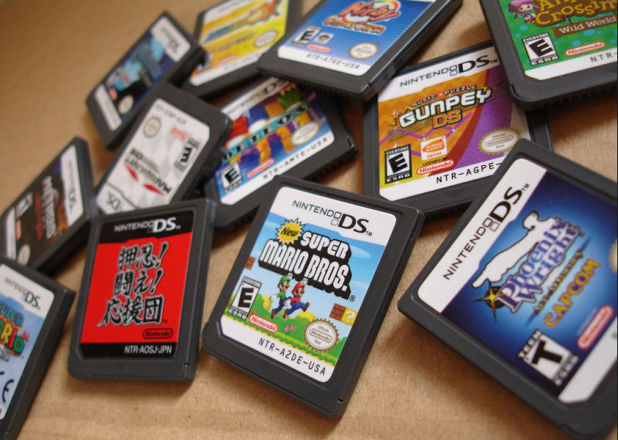
Let's talk Volume!

Slide 20
Your turn....
Well, Nintendo was able to fill the order and now business is booming! ​As a result, another company has requested games within the next two ​weeks. How many games (game has side length of 4 inches) can be ​packed inside of a shipping box whose dimensions are 5 feet by 5 feet by ​7 feet?
Post it ​check

Slide 21
Ex. 3:
A golf ball has a diameter of 1.8 inches. How many golf ​balls will fit inside of a storage unit that is 11 feet wide, 18 ​feet long, and 7 feet high?

Slide 22
You guessed it....your turn!
Post it ​check
A foam ball has a diameter of 1.2 inches. How many ​foam balls will fit inside of a storage unit that is 9 feet ​wide, 12 feet long, and 11 feet high?

