Slide 1
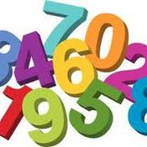
Unit 1 Lesson 2
EQ: How do I calculate large combinations for various codes?
Lesson Goal:
* Estimate large values
* Identify correct operation

Slide 2
Definitions:
Fundamental Counting Principle - positioning a set of objects where order isn't important (combinations)
Repetition - using given amount of objects continuously
No-repetitive - amount of available objects reduced by one unit
after each choice.
Example 1:
Joleen is on a shopping spree. She buys six tops, three shorts, and 4 pairs of sandals. How many different outfits consisting of a top, shorts, and sandals can she create?
Examples:
= 6 * 3 * 4 = 72 combinations

Slide 3
Examples:
Example 2 (with repetition):
How many codes are possible for a debit card pin number given the choices are 0-9 (4 digits can repeat)?
10 10 10 10 = 1,000
Example 3 (without repetition):
How many codes are possible for a debit card pin number given the choices are 0-9 (4 digits cannot repeat)?
10
9
8
7
= 5,040

Slide 4
How many license plates can be created if the first three are digits and the last three are letters (letters and digits may repeat)?

Slide 5
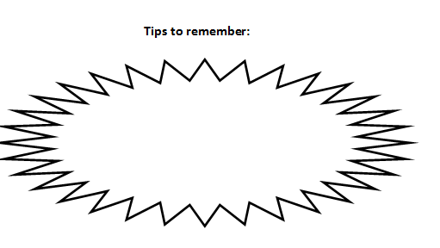

Slide 6
How many license plates can be created if the first three are digits and the second three are letters (no repeat numbers/ letters)?

Slide 7
Post it ​check
ABC - XXXX
Today license plates in Texas have the form above where ​A,B, C are non-repeating letters and X can be any ​repeating digit except 5.
How many license plates are possible in Texas?

Slide 8
NYZ - ABC - XXXX
Today all area codes had the form is NYZ, where N was ​any digit from 2 to 9, Y is 0-8, and Z is 0-9
How many area codes are possible today?

Slide 9
NYZ - ABC - XXXX
The 7-digit numbers in a given area code have the form ​ABC - XXXX where X, B, and C can be any digit 0-9 and A ​is restricted to 2-9.
How many possible phone numbers are there? (this is for ​each area code)

Slide 10
Solutions:
5. 175,760,000
6. 17,576,000
7. 1,000,000
8. 1,000,000
9. 45,697,600
10. 11,232,000
11. varies
12. 42,840
13. 64
14. 16
15. 789,360,000
16. 7,800,000
17. varies

Slide 11
ABC - XXXX
Today license plates in Texas have the form above where ​A,B, C are repeating letters and X can be any ​non-repeating digit except 5.
How many license plates are possible in Texas?

Slide 12
T.O.T.D:
What are the possible combinations for a 4-key (2 letters ​followed by 2 digits) pin if the following restrictions apply:
A: Non repeating letters
B: Cannot use A, B, D, or X
C: Non repeating digits
D: Cannot use digits 5 or 6

Slide 13
How many codes are possible for a debit card pin ​number? (4 digits can repeat)
How many codes are possible for a debit card pin ​number? (4 digits cannot repeat)

