Slide 1


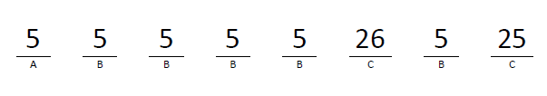
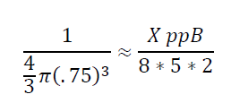
A ping-pong ball has a diameter of 1.5 in3. How many ping-pong balls will fit inside of a shipping box that is 8 feet wide, 5 feet long, and 2 feet high?
volume=
How many different passwords can generated in the form ABBBBCBC if A is an even digit C is a non-repeating letter digit and B is a non-repeating odd?

Slide 2
Warm - up 1/28/20
9 people fit comfortably in a 7 feet by 7 feet square. Use this value to estimate the size of a crowd that is 8 feet deep on ONE side of the street along a 2.5 mile section of a parade route.

Slide 3

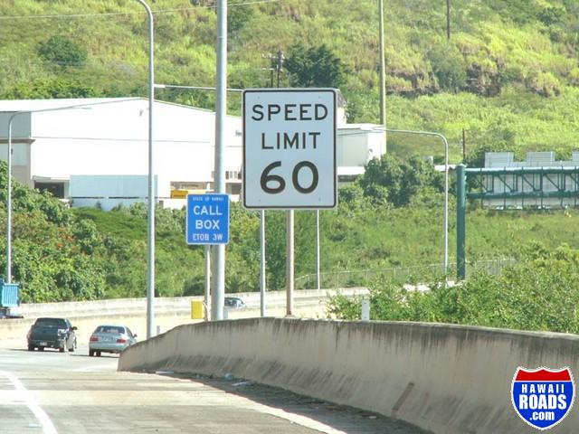
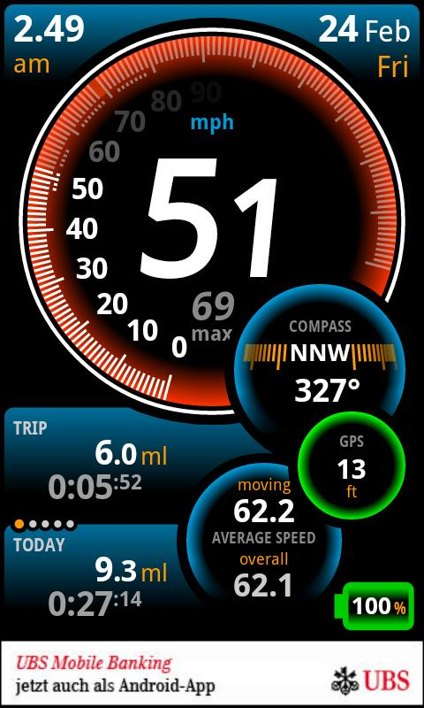

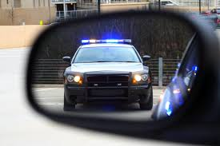
Let's THINK?
you drive by this
Then you get this.
A SPEEDING ​TICKET
Look Down and see this
Look back and see this
60

Slide 4

Lesson 3: Changing Tires
EQ: Can you get a ticket if you're driving the speed limit?

Slide 5

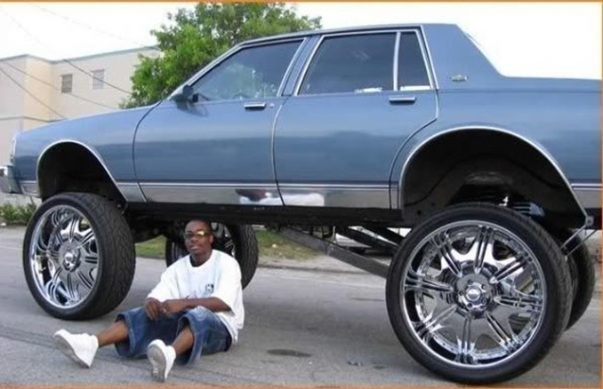


Slide 6
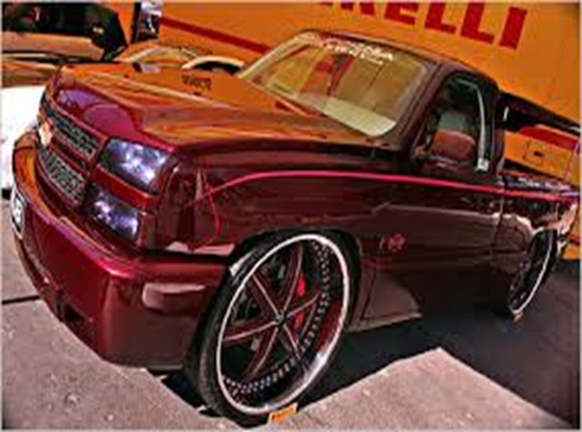

Slide 7
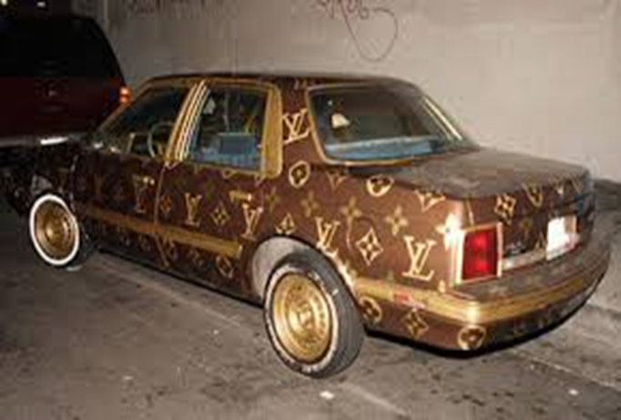

Slide 8
Homework check……
Tire | P180/65R18
Width (mm) | 180 mm
Aspect Ratio (%) | 65%
Height (in.) *** use ratios for this step | 4.60 in.
Diameter of rim (in.) | 18 inches
Diameter of entire rim plus rubber (in.) | 27.2 in.
Circumference (in.) | 85.45 in.

Slide 9

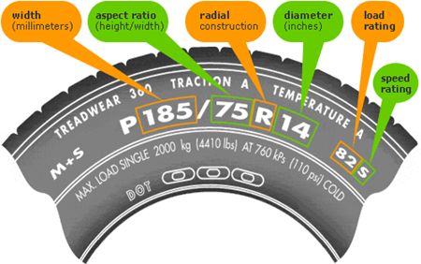

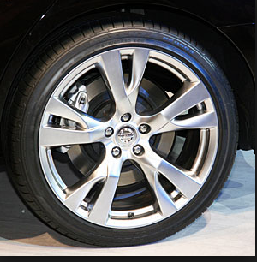
Let’s find the circumference……
Post it ​check
Tire | P215/70R19
Width (mm) | 215 mm
Aspect Ratio (%) | 70% = .70
Height (in.) *** use ratios for this step | 5.92
Diameter of rim (in.) | 19 inches
Diameter of entire rim plus rubber (in.) | 30.84
Circumference (in.) | 96.88 inches
.

Slide 10


Slide 11
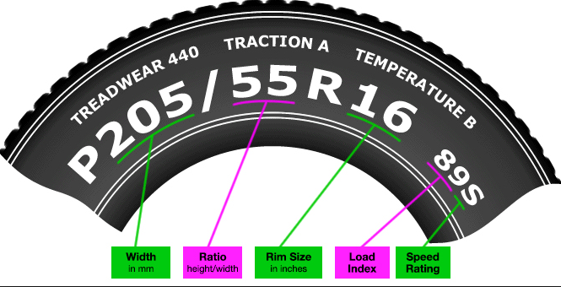
What if we purchased the tire above?
Tech time: find out what load rating and speed index means
Find diameter and circumference

Slide 12
How fast are you really going?

Slide 13
Determine actual mileage
k = new tire cir. / old tire cir.
Actual mileage = k * odometer reading
Example: The old tire circumference is 92.57 and the new tire ​circumference is 106.32:
Find k:
If the odometer reading is 150,000 miles, you actually ​traveled_____?

Slide 14

You purchased new tires with a ​circumference of 93.49 and the old tires had ​a circumference of 112.15. If the odometer ​reading is 34,700 miles, you've actually ​traveled ______________?
Post it ​check

Slide 15

Determine actual speed
k =
Actual mileage = k * speedometer reading
Using data from example #2 on notes, answer the following:
If the speedometer reading is 65 mph, how fast were you really ​driving?
South Cobb wireless
Username: Student ID
password: Cobb2018

Slide 16
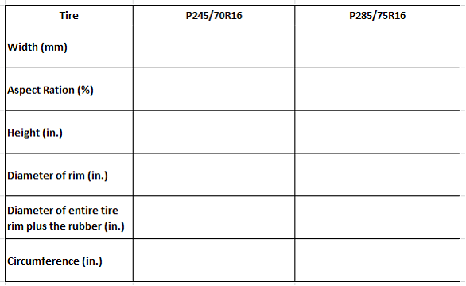

Slide 17
If the speedometer reading is 45 mph, your ​actual speed is __________?
Post it ​check

Slide 18
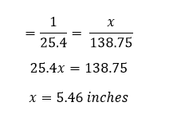
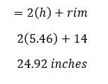
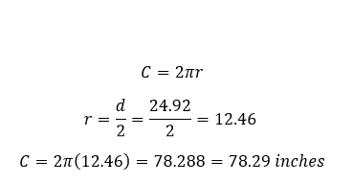
Let’s find the circumference……
Tire | P185/75R14
Width (mm) | 185 mm
Aspect Ratio (%) | 75% = 185*75=138.75
Height (in.) *** use ratios for this step
Diameter of rim (in.) | 14 inches
Diameter of entire rim plus rubber (in.)
Circumference (in.)
.

Slide 19
T.O.T.D:
If the tire reading is P175/90R19, find the following:
circumference

Slide 20
