Slide 1
Lesson 5a: Weighted averages for sports
EQ: How is the worth of an athlete determined?

Slide 2
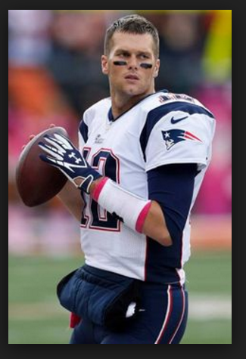
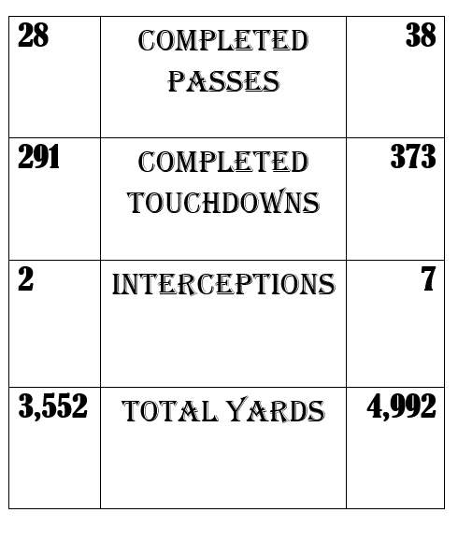
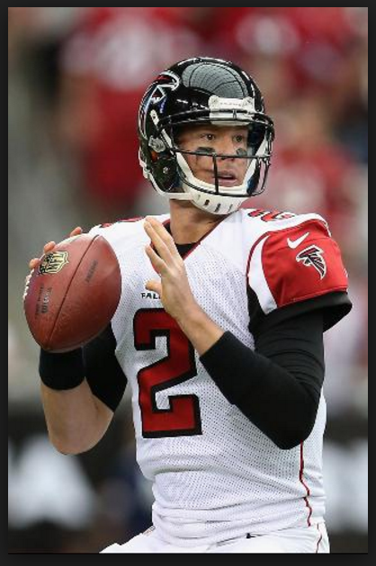
Which is better?
Attempts: Brady -432 Ryan - 534

Slide 3
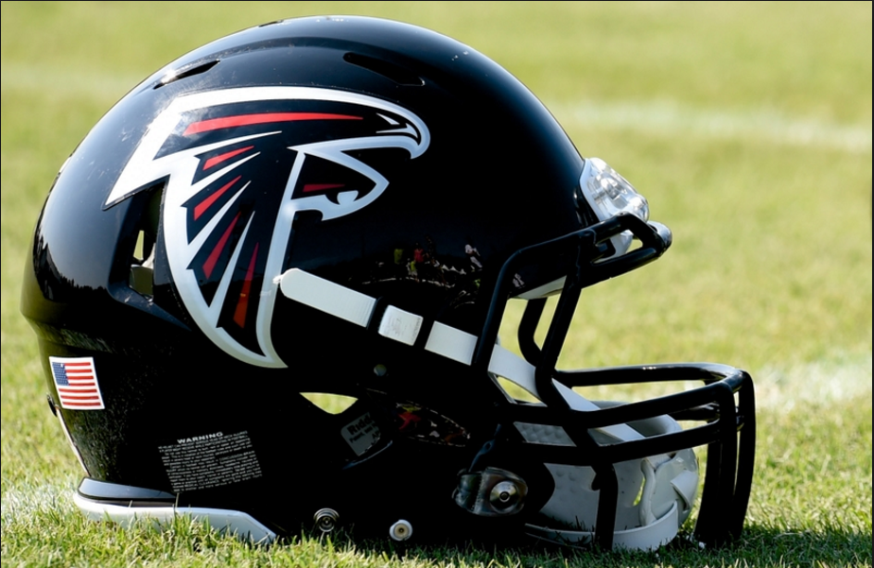
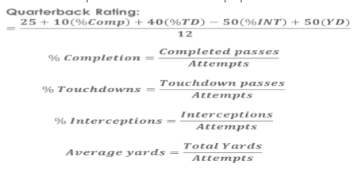
Weighted averages and football
During his rookie year, Doug Flutie had the following stats: he completed 2,154 passes in 4,120 attempts for a total of 26,300 yards, with 175 touchdowns and 79 interceptions. Find each of Brady’s percentages.
% Completion=
% Touchdowns=
% Interceptions=
Average yards =

Slide 4
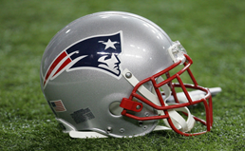
QB Rating Example
Solution:
% Comp = 2,154 /4120 = . ​52.28=52.28%
% TD = 175/4120 = .0425=4.25%
% INT = 79/4120 = .0192=1.92%
YDS = 26300/4120 =6.38
Quarterback Rating =
Quarterback Rating =
f
 | TDS | Passes | Yards | Interceptions | Attempts
Bradford | 3 | 15 | 118 | 1 | 20
Smith | 1 | 15 | 126 | 1 | 27
Find the percent of interceptions, touchdowns, completed passes, and average yards gained for the two quarterbacks below and bring to class....

Slide 5
HW solutions
% Comp. = 67.22%
%Touchdowns = 5.4%
%Interceptions = 2.19%
Avg Yards Gained = 7.19

Slide 6
Let's Practice......
Bradford had the following stats: 3 touchdowns, 15 passes, 118 yards, 1 interception, and 20 attempts. What is his percentage of completed passes?
A. 20%
B. 75%
C. 133%
D. 33%

Slide 7
Bradford had the following stats: 3 touchdowns, 15 passes, 118 yards, 1 interception, and 20 attempts. What is his average yards gained?
A. 5.9%
B. 5.90%
C. 5.9
D. 7.86

Slide 8
Geno Smith had the following stats: 1 touchdowns, 15 passes, 126 yards, 1 interception, and 27 attempts. What is his percentage of interceptions?
A. .037
B. 0.55
C. 3.7%
D. 55%

Slide 9
Geno Smith had the following stats: 1 touchdowns, 15 passes, 126 yards, 1 ​interception, and 27 attempts. What is his percentage of completed ​passes?
A. 3.7%
B. 5.5%
C. 0.55
D. 55%

Slide 10
Complete this in your notebook:
Aaron Rodgers had the following stats: 40 touchdowns, 401 completed passes, 4,428 yards, 17 interceptions, and 610 attempts. What is his quarterback rating?
QR = 25 + 10(65.73) + 40(6.55) - 50(2.78) + 50(7.25) = 97.31
12

Slide 11
Completed Passes
Yards
Gained
Attempts
Inter.
TD
QR
Tom Brady
Ben Roethlisberger
Drew Brees
Dak Prescott
385
360
386
308
581
561
536
490
8
14
8
13
32
28
23
22
286.1
283.4
270.9
207.8

Slide 12
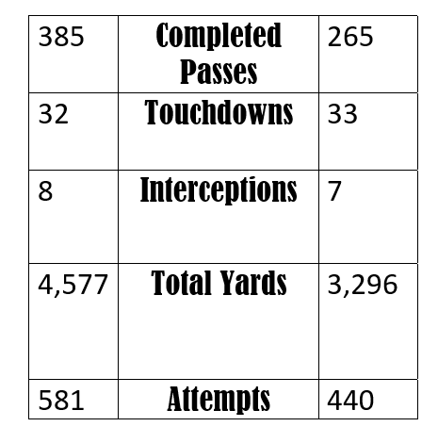
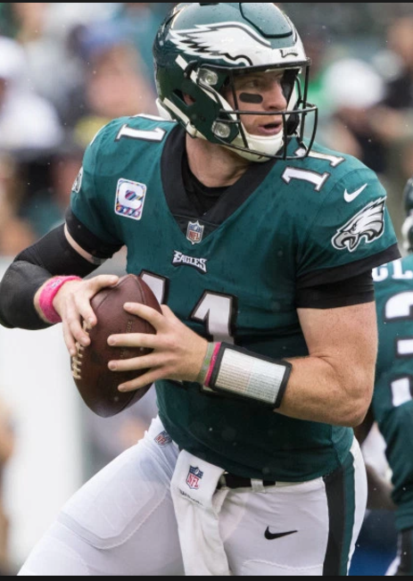
Calculate QR
Left (W) - Brady Right (d) - Wentz

Slide 13
9:00 appt - sit on opposite side of room from yesterday
Lesson 5b: Weighted averages for sports
EQ: How is the worth of an athlete ​determined?

Slide 14
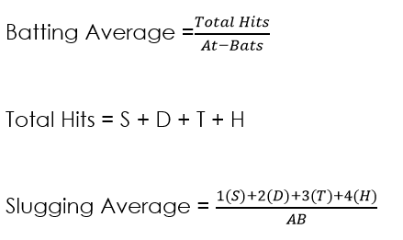
Which player would you rather have on your ​team?
Andruw | 83 | 27 | 2 | 26 | 593
Chipper | 80 | 23 | 2 | 18 | 488

Slide 15
Which player would you rather have on your ​team?
Andruw | 83 | 27 | 2 | 26 | 593
Chipper | 80 | 23 | 2 | 18 | 488
Total Hits =
Batting Avg. =
Andruw:
Slugging Avg. =

Slide 16
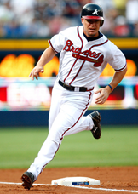
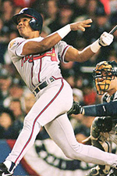
SLUGGING AVERAGE
CHIPPER IT IS!!!!!!!!!!

Slide 17
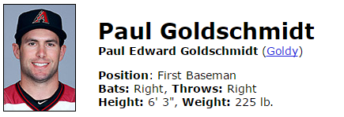
Who's worth more?
Slugging ​Average
Singles | Doubles | Triples | Homeruns | Total hits | At-bats
57 | 16 | 0 | 22 | 95 | 389
Singles | Doubles | Triples | Homeruns | Total hits | At-bats
43 | 5 | 3 | ??? | 51 | 183
singles | Doubles | Triples | Homeruns | Total Hits | At-bats
??? | 23 | 1 | 4 more than doubles | 140 | 459
Singles | Doubles | Triples | Homeruns | Total hits | At-bats
87 | 9 times more than triples | 3 | 19 | ??? | 448

Slide 18
Ryan had the following stats from this season; 34 singles, 12 doubles, 9 homeruns and 300 at bats. There were two times more triples than homeruns. WHat is the slugging average?

Slide 19
Absent Student Report
Some of your colleagues aren't here today; you will write a paragraph (4-5 ​complete sentences) to include the following:
- compare batting and slugging average
- describe how these averages are relevant to the sporting industry

Slide 20
Weighted averages and football
image of falcons ​helmet
As of 2013, Tom Brady had the highest career quarterback rating in NFL ​history. He completed 2,154 passes in 4,120 attempts for a total of 26,300 ​yards, with 175 touchdowns and 79 interceptions. Find each of Brady’s ​percentages.

